Slide 1
2016
Software Engineering
Speaker：Fu Jianwen & Ken &Nut

Slide 2
CONTENTS
Part 1
Part 2
Part 3
Part 4
Part 5
Architecture design
Component design
Interface design
Database design
Design
document

Slide 3
Part1
Architecture design

Slide 4
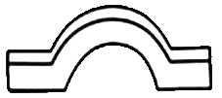
What is architecture design?
a bridge that requirement analysis to software implementation, and it is also the key to determine the quality of software.
Requirement analysis
Software implementation
Architecture Design

Slide 5
How to design architecture?
1.Understand the Problem
2.Indentify Design Elements and their Relationships
3.Evaluate the architecture Design
4.Tranform the Architecture Design
Architecture Design Process
Notes:
Understand the Problem
This is the most crucial step because it affects the quality of the design that follows. Without a clear
understanding of the problem, it is not possible to create an effective solution. In fact, many software
projects and products are considered as unsuccessful because they did not actually solve a valid business
problem or have a recognizable return on investment (ROI).
Identify Design Elements and their Relationships
In this phase, build a baseline for defining the boundaries and context of the system. Decomposition of the
system into its main components is based on the functional requirements. The decomposition can be
modeled by using a design structure matrix (DSM), which shows the dependencies between design
elements without specifying the granularity of the elements.
In this step, the first validation of the architecture is done by describing a number of system instances and
this step is referred as functionality based architectural design.
Evaluate the Architecture Design
Each quality attribute is given an estimate, so in order to gather qualitative measures or quantitative data,
the design is evaluated. It involves evaluating the architecture for conformance to architectural quality
attributes requirements.
If all the estimated quality attributes are as per the required standard, the architectural design process is
finished. If not, then the third phase of software architecture design is entered: architecture transformation.
However, if the observed quality attribute does not meet its requirements, then a new design must be
created.
Transform the Architecture Design
This step is performed after an evaluation of the architectural design. The architectural design must be
changed until it completely satisfies the quality attribute requirements. It is concerned with selecting design
solutions to improve the quality attributes while preserving the domain functionality.
Further, a design is transformed by applying design operators, styles, or patterns. For transformation, take
the existing design and apply design operator such as decomposition, replication, compression, abstraction,
and resource sharing.
Moreover, the design is again evaluated and the same process is repeated multiple times if necessary and
even performed recursively. The transformations (i.e. quality attribute optimizing solutions) generally
improve one or some quality attributes while they affect others negatively.

Slide 6
Principles
Separation of concerns.
Single Responsibility principle.
Principle of Least Knowledge (also known as the Law of Demeter or LoD).
Don’t repeat yourself (DRY).
Minimize upfront design.
Notes:
Separation of concerns. Divide your application into distinct features with as little overlap in functionality as possible. The important factor is minimization of interaction points to achieve high cohesion and low coupling. However, separating functionality at the wrong boundaries can result in high coupling and complexity between features even though the contained functionality within a feature does not significantly overlap.
Single Responsibility principle. Each component or module should be responsible for only a specific feature or functionality, or aggregation of cohesive functionality.
Principle of Least Knowledge (also known as the Law of Demeter or LoD). A component or object should not know about internal details of other components or objects.
Don’t repeat yourself (DRY). You should only need to specify intent in one place. For example, in terms of application design, specific functionality should be implemented in only one component; the functionality should not be duplicated in any other component.
Minimize upfront design. Only design what is necessary. In some cases, you may require upfront comprehensive design and testing if the cost of development or a failure in the design is very high. In other cases, especially for agile development, you can avoid big design upfront (BDUF). If your application requirements are unclear, or if there is a possibility of the design evolving over time, avoid making a large design effort prematurely. This principle is sometimes known as YAGNI ("You ain’t gonna need it").

Slide 7
A software architecture can be defined in many ways
UML (Unified Modeling Language)
Architecture View Model (4+1 view model)
ADL (Architecture Description Language)
Notes:
A software architecture must describe its group of components, their connections, interactions among them and deployment configuration of all components.
− UML is one of object-oriented solutions used in software modeling and design.
Architecture view model represents the functional and non-functional requirements of software application.
ADL defines the software architecture formally and semantically.

Slide 8
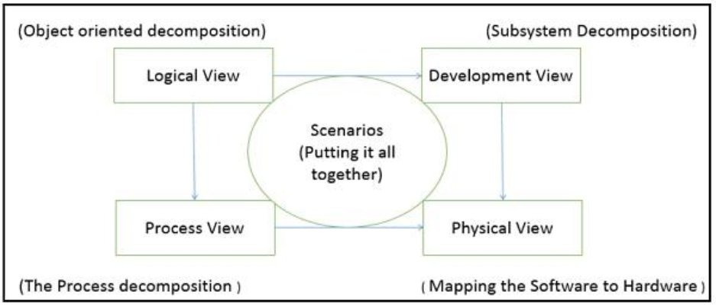
4+1 View

Slide 9
 | Logical | Process | Development | Physical | Scenario
Description | Shows the component(Object) of system as well as their interaction | Shows the process/workflow rules of system and how those process communicate, focuses on dynamic view of system | Gives building block views of system and describe static organization of the system modules | Shows the installation, configuration and deployment of software application | Shows the design is complete by performing validation and illustration
Viewer/Stake holder | End-User, Analysis and Designer | Integration & developer | Programmer and software project managers | System engineer, operators, system administrators and system installers | All the views of their views and evaluators
Consider | Functional requirement | Non-Functional Requirements | Software Module organization(Software management reuse, constraint of tools) | Nonfunctional requirement regarding to underlying hardware | System consistency and validity
UML Diagram | Class, State, Object, sequence, Communication Diagram | Activity Diagram | Component, Package Diagram | Deployment Diagram | Use case diagram
Notes:
注意角色的解释

Slide 10
Architecture overall design
Overall Design
Module Design
Integration Design
Interaction Overview Diagrams
Component Diagram
Deploy Design
Deployment Diagram
Package Diagram
Model Diagram
Network architecture Diagram
Domain design
Information flow Diagram

Slide 11
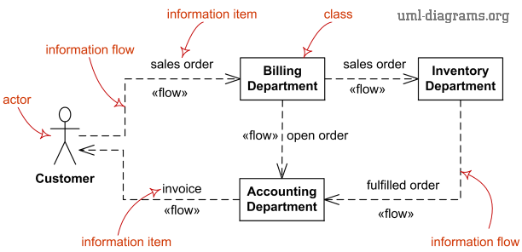
Information Flow Diagram
Notes:
shows exchange of information between system entities at some high levels of abstraction. Information flows may be useful to describe circulation of information through a system by representing aspects of models not yet fully specified or with less details.

Slide 12
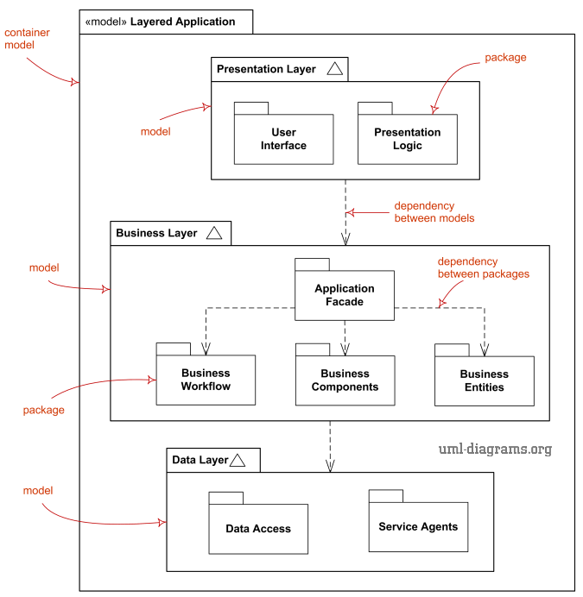
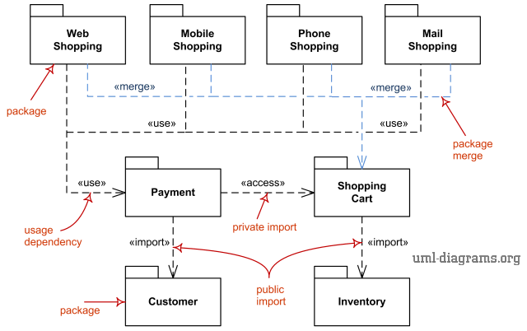
Model Design
Package Diagram
Model Diagram
Notes:
Package diagram is UML structure diagram which shows structure of the designed system at the level of packages. The following elements are typically drawn in a package diagram: package, packageable element, dependency, element import, package import, package merge.
Model diagram is UML auxiliary structure diagram which shows some abstraction or specific view of a system, to describe architectural, logical or behavioral aspects of the system. It could show, for example, architecture of a multi-layered (aka multi-tiered) application - multi-layered application model.

Slide 13
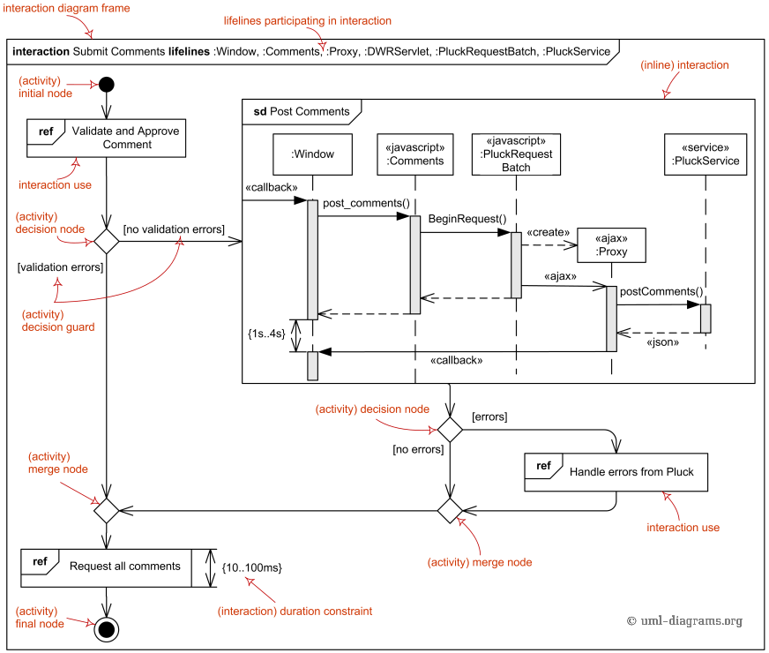
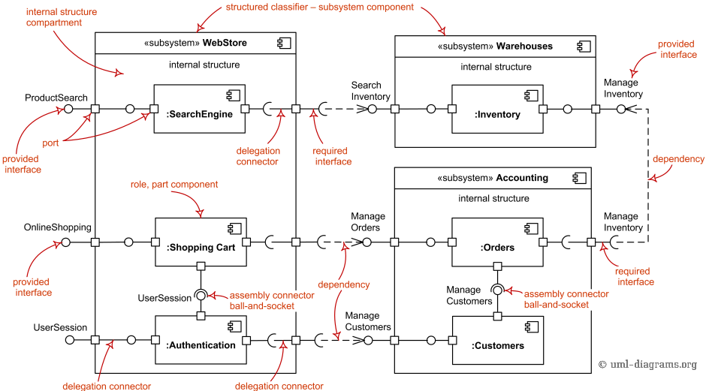
Integration Design
Interaction Overview Diagram
Component Diagram
Notes:
Interaction overview diagrams provide overview of the flow of control where nodes of the flow are interactions or interaction uses. in some places relegates these diagrams as interaction diagrams while in other places interaction overview diagrams are referred to as specialization of activity diagrams.
Component diagram shows components, provided and required interfaces, ports, and relationships between them. This type of diagrams is used in Component-Based Development (CBD) to describe systems with Service-Oriented Architecture (SOA).
Component-based development is based on assumptions that previously constructed components could be reused and that components could be replaced by some other "equivalent" or "conformant" components, if needed.
The artifacts that implement component are intended to be capable of being deployed and re-deployed independently, for instance to update an existing system.
Components in UML could represent
logical components (e.g., business components, process components), and
physical components (e.g., CORBA components, EJB components, COM+ and .NET components, WSDL components, etc.),

Slide 14
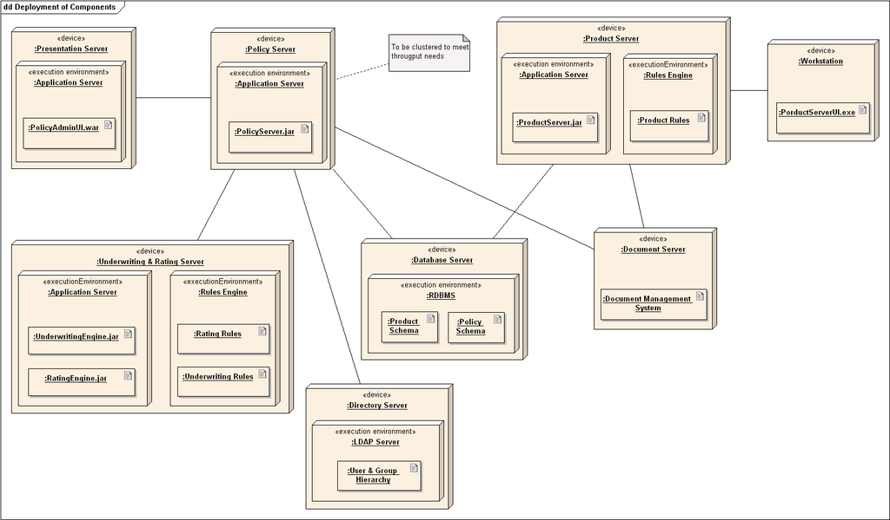
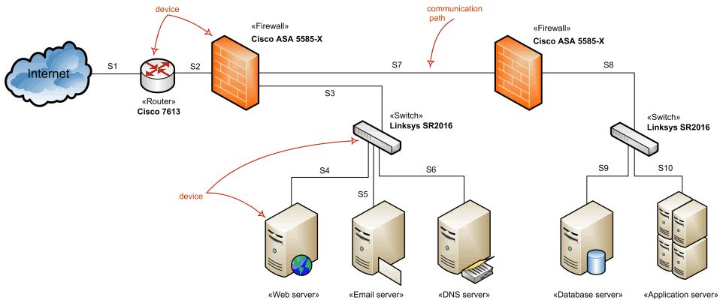
Deploy Design
Deployment Overview Diagram
network Diagram
Notes:
Deployment diagram is a structure diagram which shows architecture of the system as deployment (distribution) of software artifacts to deployment targets.
Artifacts represent concrete elements in the physical world that are the result of a development process. Examples of artifacts are executable files, libraries, archives, database schemas, configuration files, etc.
Deployment target is usually represented by a node which is either hardware device or some software execution environment. Nodes could be connected through communication paths to create networked systems of arbitrary complexity.
Network architecture diagram will usually show networking nodesand communication paths between them.
Switch devices
Router devices
Load balancing devices
Firewall devices
Virtual Private Network (VPN) devices

Slide 15
Part2
Component design
Notes:
I will introduce the Component design and Interface design

Slide 16
What is a Component?
Views of Component
Object-oriented
Conventional
Process-related
A set of collaborating classes
A functional element or a module of a program that integrates the processing logic and the internal data structures
Instead of creating each component from scratch, the system is building from existing components maintained in a library
Notes:
So what is a Component?
The component have three views: Object-oriented, Conventional and Process-related
In Object-oriented View, component is a set of collaborating classes,
in conventional view, component is a functional element or a module that have logic and data structures.
Process-related like a library, you can select existing components in the library.

Slide 17
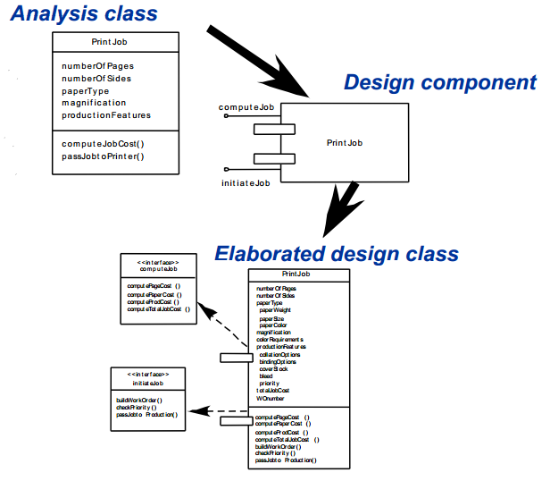
Object-oriented Component
Notes:
For object-oriented component, it is from an analysis class, then you design a component and have some interfaces, at last, you elaborated the class, so the class have all details.

Slide 18
Design Principles
The Open-Closed Principle (OCP).
A module [component] should be open for extension but closed for modification.
The Liskov Substitution Principle (LSP).
Subclasses should be substitutable for their base classes.
Dependency Inversion Principle (DIP).
Depend on abstractions. Do not depend on concretions.
The Interface Segregation Principle (ISP).
Many client-specific interfaces are better than one general purpose interface.
Notes:
The component design have four principles:
The open-closed principle, you can make internal code to extend but can’t modify the existing parts of the component.
The Liskov substitution principle, if a component uses a base class, then you should guarantee the base class can be replaced by a subclass.
Dependency inversion principle, the component should rely on a interface or abstract class not a concrete component.
Interface segregation principle, the client should rely on smallest interfaces, throws those it don’t need, so don’t make a general interface, should divide many specific interfaces.

Slide 19
How to design Component?
Identify design classes in problem domain
From analysis model
Identify design classes in infrastructure domain
GUI components, data management components, networking components, etc.
Elaborate design classes
Specify message details
Interfaces
Attributes, data types and data structures
Processing flow (Activity diagrams)
Notes:
So we know the principles about the component, but how to design a component?
First step, identify all design classes in problem domain, usually they are from a analysis model. The problem domain is the problems in reality that software need to solve, like you develop a system for hospital, then you must know the system solve what problems, like doctor and patient, what connection about the two roles, and the work process for doctor and patient. You make a analysis model from the problem domain and then identify some classes, like doctor and patient can make classes.

Slide 20
How to design Component?
4) Describe persistent data sources
Databases and files, etc.
5) Elaborate behavioral representations
State diagrams
6) Elaborate deployment
Deployment diagrams
7) Redesign or reconsider
Redesign before settling on the final design model
Reconsider design principles and guidelines
Notes:
Identify design classes in infrastructure domain. Many thing can’t get from problem domain, so you should identify GUI components, data management components, networking components, etc.
After identify all classes, you should elaborate the design classes. The content include message detail about classes or components, appropriate interfaces for each component, attributes, data types and data structures, processing flow. We usually use Activity diagrams to describe the processing flow.
Describe persistent data sources, like databases and files and identify the classes to manage them.
Elaborate behavioral representations for a class or a component. We usually use state diagrams to describe the state change.
Elaborate deployment. Illustrate the location of key packages or classes of components in a system.

Slide 21
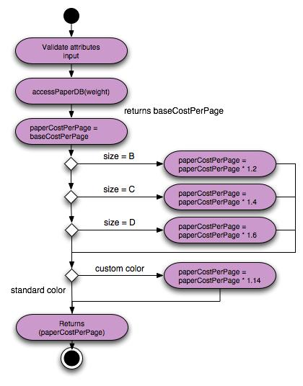
Activity Diagram
In the UML, activity diagrams are intended to model both computational and organizational processes (i.e. workflows).Activity diagrams show the overall flow of control.
Notes:
The Activity diagram we use in Step 3 for describe the processing flow. The Activity diagram show the overall flow of control.

Slide 22
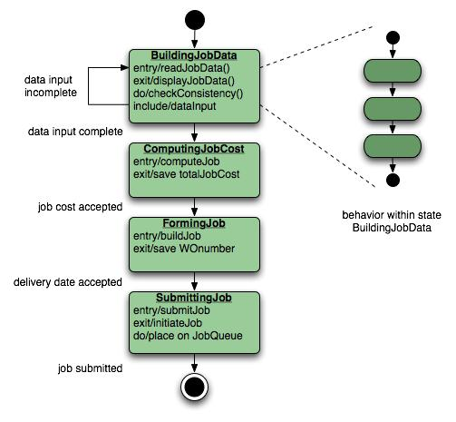
State Diagram
Each diagram usually represents objects of a single class and track the different states of its objects through the system
Notes:
The State Diagram use in step 5 and its function is to show the transitions from state to state.

Slide 23
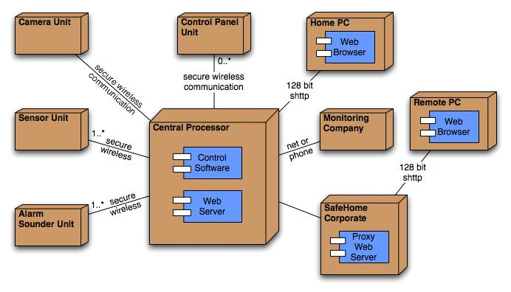
Deployment Diagram
Deployment diagrams are elaborated to represent the location of key packages or components.
Notes:
Deployment Diagram is used in step 6, it represent the location of key packages of components

Slide 24
Part3
Interface design(API & UI)
Notes:
Interface design contains Application Programming Interface and User Interface.

Slide 25
API(Application Programming Interfaces) Design
Key design principle: Information hiding
Design process:
• Define the scope of the API Collect use-case stories, define requirements
• Draft a specification, gather feedback, revise, and repeat
Keep it simple, short
• Code early, code often Write client code before you implement the API
Notes:
The key principle of design API is information hiding, that is you hides information between layer and layer, class and class, and the attribute in a class. You get something from an interface but you don’t know the process about that.
The design process, at first you should define the scope of the API, the API should be as small as possible but should satisfy its requirements
Draft a specification, gather feedback, revise, and repeat. You should keep it simple and short, so it need to be found problems and redesign.
Code early and code often. You should design API before you have implemented the API or specified it properly. And you should often to design something like examples or unit tests.

Slide 26
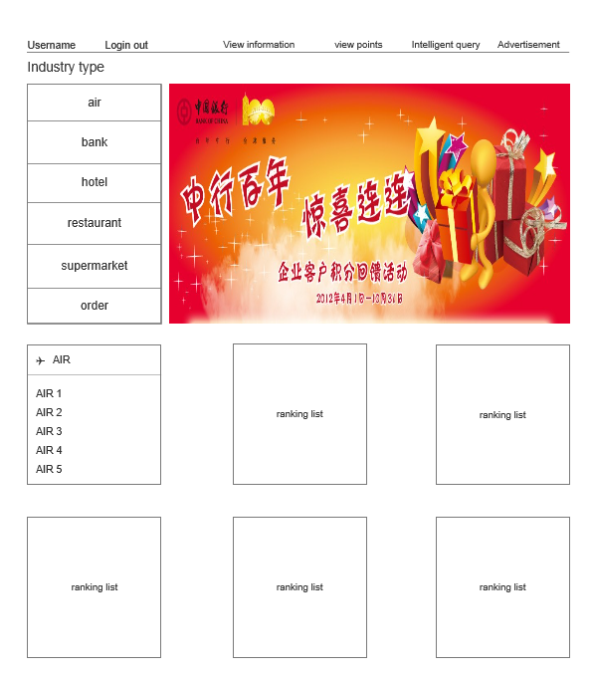
UI(User Interface) Design
UI is the junction between users and computer program. An interface is a set of commands or menus that for users communicating with the program.
The interface design to grasp the main content for the overall style, including color, appearance, and other elements of the page.
Notes:
UI is the junction between the user and computer program. Interface design just to grasp the main content for overall style, like color, appearance, and other elements of the page.

Slide 27
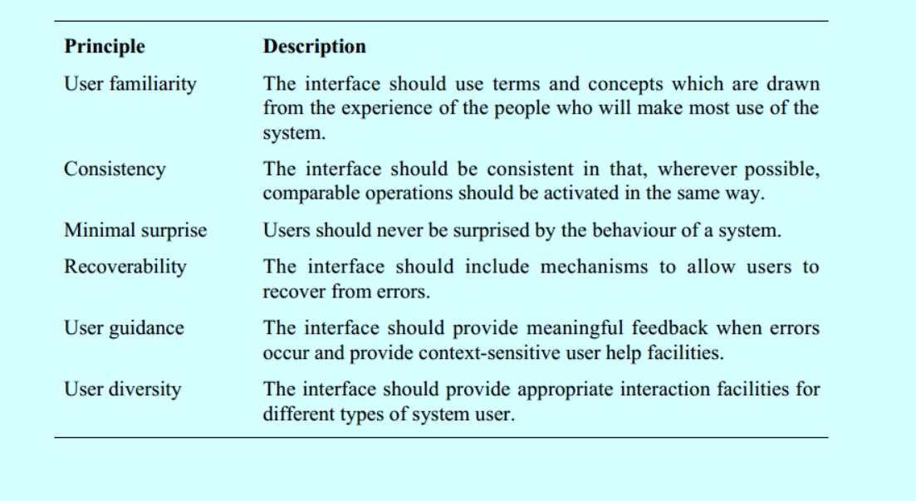
UI Design Principles
Notes:
UI Design Principles:
User familiarity: the interface should use something that user is familiar to design.
Consistency: The interface should be consistent. The elements of the page or the operation should use same way.
Minimal surprise: Just don’t make users surprise when they operate the system.
Recoverability: when the system have errors, the interface have some mechanism to recover.
User guidance: When errors occur, interface should provide some guidance or help facilities. For example, the print program may be occur error when the computer can’t find the printer, so the interface should remind user to connect the printer.
User diversity: The Interface should provide appropriate interaction facilities for different types of system user. For example, an APP may have IOS version, Android version, mobile version and Pad version.

Slide 28
Part4
Database design

Slide 29
Database Design Process
Step
Determine the data to be stored in the database.
Determine the relationships between the different data elements.
Superimpose a logical structure upon the data on the basis of these relationships.

Slide 30
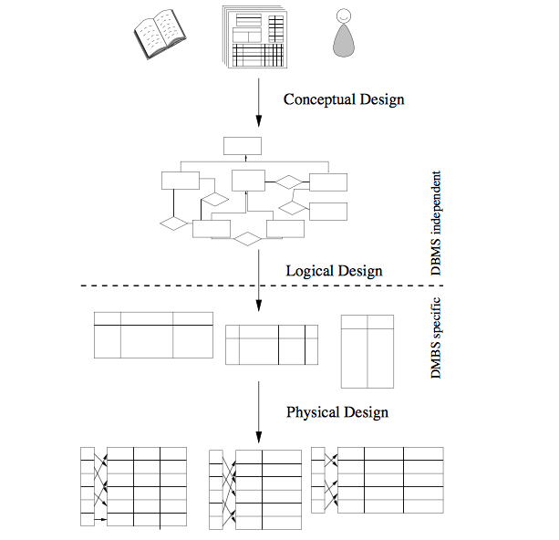

Slide 31
ER Diagram
Database designs also include ER diagrams. An ER diagram is a diagram that helps to design databases in an efficient way.
Attributes in ER diagrams are usually modeled as an oval with the name of the attribute, linked to the entity or relationship that contains the attribute.

Slide 32
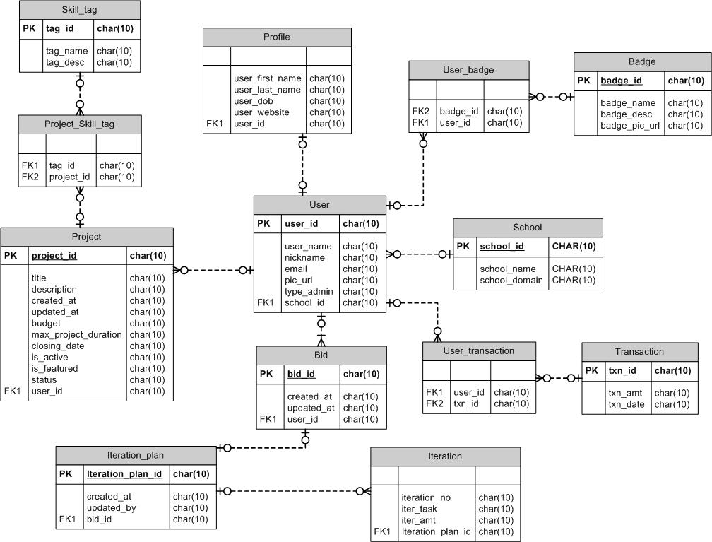

Slide 33
Part5
Design document

Slide 34
Software design document
Outline design:
Explain the system module division, technical framework, and define design criteria, decomposition and partition function module, define the function of each function module and business process, define the interface between modules.
Detailed design:
Define the functional units of each functional module in detail, including the physical definition of the interface and the physical definition of the database, etc..

Slide 35
Software design document
Content of outline design:
1. System architecture design
2. Function module design
3. System interface design
4. Database design
Content of detailed design:
Module interface design
Module function design
Front end design(Web Design)

Slide 36
What is the function of the design document?
Problem can be found in advance.
Reduce the occurrence of iterative development.
Reduce the development time and costs.
Be able to look forward to the entire project.
Development and testing can have common standards.
Thorough solution to the dependence of the software on the specific developer.

Slide 37
THANK
YOU

